Slide 1
NumPy
CAP776
PROGRAMMING IN PYTHON

Slide 2
Introduction to NumPy
arrays vs lists,
array creation routines,
arrays from existing data,
indexing and slicing,
Operations on NumPy arrays,
array manipulation,
broadcasting, binary operators,
NumPy functions: mathematical functions, statistical functions, sort, search and counting functions

Slide 3
NumPy
NumPy stands for Numerical Python
NumPy is the core library for scientific and numerical computing in Python.
It provides various computing tools such as comprehensive mathematical functions, linear algebra routines.
There are various ways to create arrays in NumPy:
You can create an array from a regular Python list or tuple using the array function.
Functions to create arrays: np.zeros, np.ones, np.empty, etc.

Slide 4
Installation of NumPy
!pip install numpy
Once NumPy is installed, import it in your applications by adding the import keyword:
import numpy
Create an alias with the as keyword while importing:
import numpy as np
Checking NumPy Version
The version string is stored under __version__ attribute
import numpy as np
print(np.__version__)

Slide 5
Continue…
Array creation using array functions :
array(value list)
import numpy as np
arr = np.array([1, 2, 3, 4, 5])
Use a tuple to create a NumPy array:
import numpy as np
arr = np.array((1, 2, 3, 4, 5))

Slide 6
Continue…
Create a 1-D array containing the values 1,2,3,4,5:
import numpy as np
arr = np.array([1, 2, 3, 4, 5])

Slide 7
Access Array Elements
Array indexing is the same as accessing an array element.
You can access an array element by referring to its index number.
import numpy as np
arr = np.array([1, 2, 3, 4])
print(arr[1])

Slide 8
Example
# printing original array
import numpy as np
arr = np.array([1, 2, 3, 4,5])
print ("The new created array is : ",end="")
for i in range (0,5):
print (arr[i], end=" ")

Slide 9
Using arange() function to create a Numpy array:
arange(start, end, step)
Example:
arange_array = np.arange(0,11,2)
print(arange_array)

Slide 10
Reverse Array
arr2 = np.arange(20,0,-1)
print("Reverse Array", arr2)

Slide 11
arrays vs lists
A list in Python is a collection of items which can contain elements of multiple data types. It is an ordered collection supporting negative indexing. A list can be created using [] containing data values.
An array is a vector containing homogeneous elements i.e. belonging to the same data type. Elements are allocated with contiguous memory locations allowing easy modification, that is, addition, deletion, accessing of elements.

Slide 12
Array creation routines
The ndarray object can be constructed by using the following routines:
Numpy.empty
The empty routine is used to create an uninitialized array of specified shape and data type.
The syntax is given below.
numpy.empty(shape, dtype = data_type)

Slide 13
Example
import numpy as np
arr = np.empty((3,2), dtype = int)
print(arr)

Slide 14
NumPy.Zeros
This routine is used to create the numpy array with the specified shape where each numpy array item is initialized to 0.
import numpy as np
arr = np.zeros((3,2), dtype = int)
print(arr)

Slide 15
NumPy.ones
This routine is used to create the numpy array with the specified shape where each numpy array item is initialized to 1.
import numpy as np
arr = np.ones((3,2), dtype = int)
print(arr)

Slide 16
Numpy array from existing data
creating numpy array using the list
import numpy as np
l=[1,2,3,4,5,6,7]
a = np.asarray(l);
print(type(a))
print(a)

Slide 17
numpy.asarray()
This function is similar to numpy.array except for the fact that it has fewer parameters.
This routine is useful for converting Python sequence into ndarray.
numpy.asarray(a, dtype = None, order = None)

Slide 18
creating a numpy array using Tuple
import numpy as np
l=(1,2,3,4,5,6,7)
a = np.asarray(l);
print(type(a))
print(a)

Slide 19
creating a numpy array using more than one list
import numpy as np
L1=[[1,2,3,4,5,6,7],[8,9]]
a = np.asarray(l);
print(type(a))
print(a)

Slide 20
Create a 2-D array containing two arrays with the values 1,2,3 and 4,5,6:
import numpy as np
arr = np.array([[1, 2, 3], [4, 5, 6]])

Slide 21
Quiz
import numpy as np
a = np.array([1, 2, 3])
b = np.array([1, 1, 1])
c = a + b
print(c)
[1,2,3,1,1,1]
[1,1,1,1,2,3]
[2,3,4]
None

Slide 22
NumPy Bitwise Operators
bitwise_and
bitwise_or
invert
left_shift
right_shift

Slide 23
bitwise_and
import numpy as np
a = 10
b = 12
print("binary representation of a:",bin(a))
print("binary representation of b:",bin(b))
print("Bitwise and of a and b: ",np.bitwise_and(a,b))

Slide 24
bitwise_or Operator
import numpy as np
a = 50
b = 90
print("binary representation of a:",bin(a))
print("binary representation of b:",bin(b))
print("Bitwise-or of a and b: ",np.bitwise_or(a,b))

Slide 25
Invert operation
It is used to calculate the bitwise not the operation

Slide 26
left_shift()
import numpy as np
a = 10
print ('Left shift of 10 by two positions:')
print (np.left_shift(10,2))

Slide 27
right_shift
import numpy as np
print 'Right shift 40 by two positions:'
print (np.right_shift(40,2) )

Slide 28
String functions
numpy.char.add()
import numpy as np
Print( 'Concatenate two strings:’ )
Print( np.char.add(['hello'],[' xyz’]) )
print ('\n’)

Slide 29
numpy.char.multiply()
import numpy as np
print np.char.multiply('Hello ‘,3)

Slide 30
numpy.char.center()
This function returns an array of the required width so that the input string is centered and padded on the left and right with fillchar.
import numpy as np
# np.char.center(arr, width,fillchar)
print np.char.center('hello', 20,fillchar = '*')

Slide 31
numpy.char.capitalize()
This function returns the copy of the string with the first letter capitalized.
import numpy as np
Print( np.char.capitalize('hello world’))

Slide 32
Operations on NumPy arrays
You can perform arithmetic directly on NumPy arrays, such as addition and subtraction.
For example, two arrays can be added together to create a new array where the values at each index are added together.

Slide 33
Example
import numpy as np
a = np.array([1, 2, 3])
b = np.array([1, 1, 1])
c = a + b
print(c)
a = [1, 2, 3]
b = [1, 1, 1]
c = a + b
c = [1 + 1, 2 + 1, 3 + 1]

Slide 34
Limitation with Array Arithmetic
Arithmetic may only be performed on arrays that have the same dimensions and dimensions with the same size.
Arrays with different sizes cannot be added, subtracted, or generally be used in arithmetic.
A way to overcome this use array broadcasting and is available in NumPy

Slide 35
arithmetic operations
For performing arithmetic operations such as add(), subtract(), multiply(), and divide() must be of the same shape.
import numpy as np
a = np.array([10,20,30])
b = np.array([1,2,3])
print(a.shape)
print(b.shape)
print(np.add(a,b))
print(np.subtract(a,b))
print(np.multiply(a,b))
print(np.divide(a,b))

Slide 36
Example:
import numpy as np
a1=np.array([10,20,30])
b1=np.array([1,2,3,4])
print(a1+b1)

Slide 37
You can perform arithmetic operations Main rule:
Size of each dimension should be same
Size of one of the dimension should be 1.

Slide 38
array broadcasting rule
Rule1: If the two arrays differ in their number of dimensions, the shape of the one with fewer dimensions is padded with ones on its leading (left) side.
Rule2: If the shape of the two arrays does not match in any dimension, the array with shape equal to 1 in that dimension is stretched to match the other shape.
Rule3: If in any dimension the sizes disagree and neither is equal to 1, an error is raised.

Slide 39
Check with example:
a1=[10,20,30]
shape:3
dimension:1D
b1=[1,2,3,4]
shape:4
dimension:1D
Rule1: not satisfied
Rule2:not satisfied
import numpy as np
a1=np.array([10,20,30])
b1=np.array([1,2,3,4])
print(a1+b1)

Slide 40
Check with another example2
import numpy as np
a1=np.array([[1,2],[3,4],[5,6]])
b1=np.array([10,20])
print(a1+b1)
a1:
Shape: 3,2
Dimension:2D
b1:
Shape:2
Dimension:1D

Slide 41
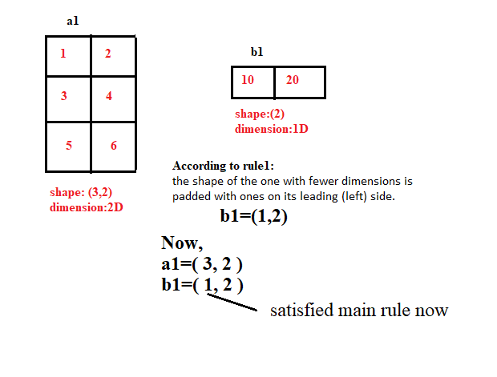

Slide 42
Check with another example3
import numpy as np
a1=np.array([[1,2],[3,4],[5,6]])
b1=np.array([10,20,30])
print(a1+b1)
a1:
Shape: 3,2
Dimension:2D
b1:
Shape:3
Dimension:1D

Slide 43
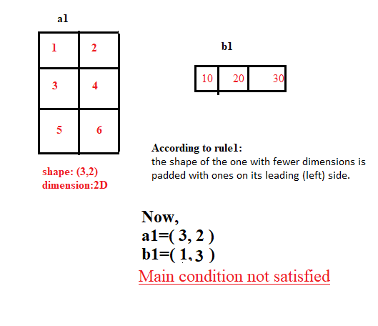

Slide 44
Check with another example4
import numpy as np
a1=np.array([[1,2],[3,4],[5,6]])
b1=np.array([[10,20],[30,40]])
print(a1+b1)
a1:
Shape: 3,2
Dimension:2D
b1:
Shape:2,2
Dimension:2D

Slide 45
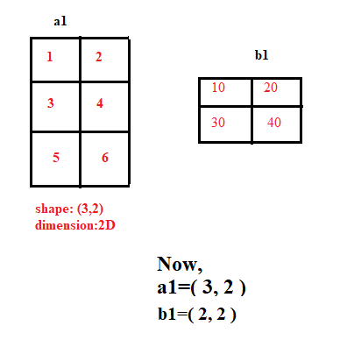

Slide 46
mathematical functions
Trigonometric Functions
Logarithms Functions

Slide 47
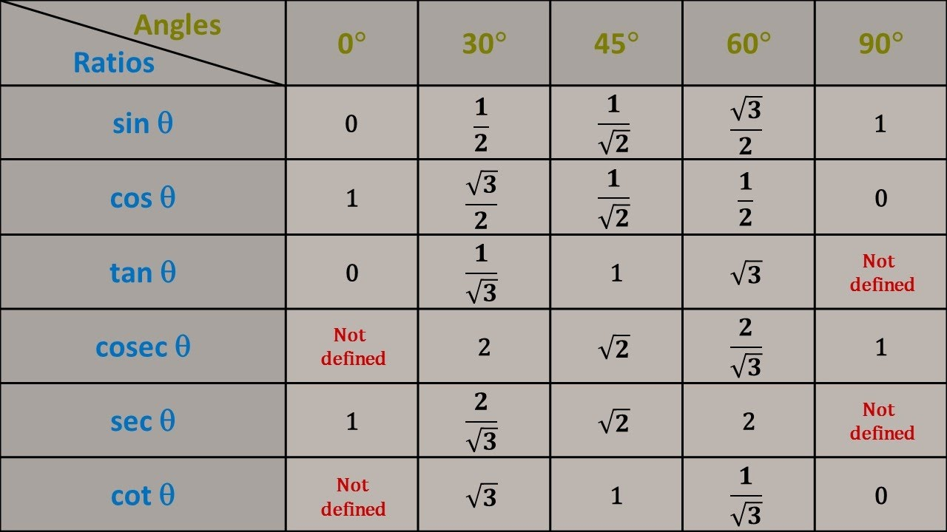
Trigonometric Functions

Slide 48
Trigonometric Functions
numpy.sin() NumPy function help to find sine value of the angle in degree and radian.
numpy.cos() NumPy function help to find cosine value of the angle in degree and radian.
numpy.tan() NumPy function help to find tangent value of the angle in degree and radian.

Slide 49
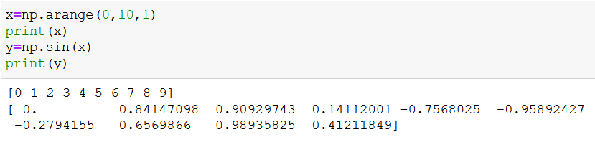
Example:

Slide 50
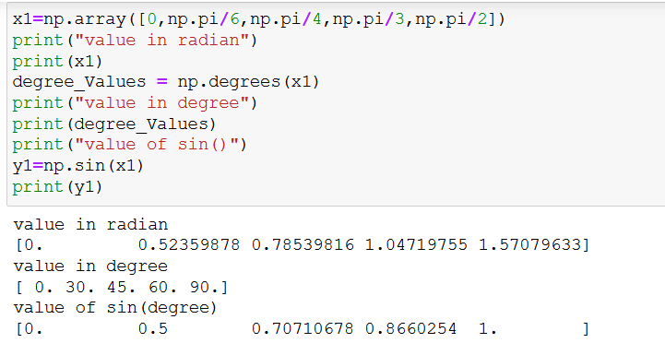
Example

Slide 51
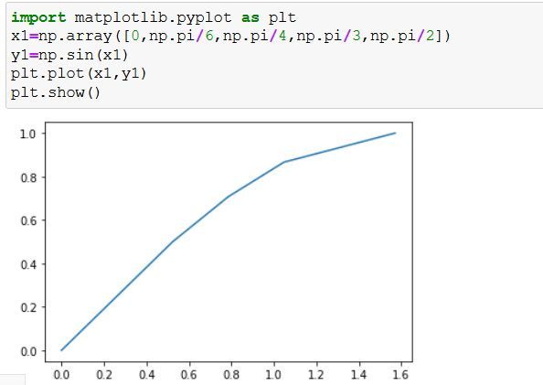
Example with graph

Slide 52
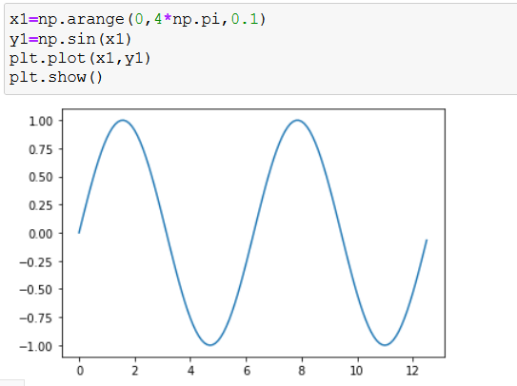
Example with graph

Slide 53
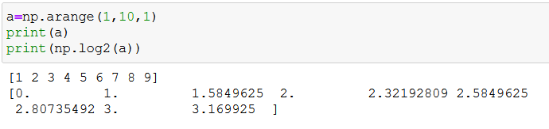
Logarithms Functions
Base 2: log2()
Base 10: log10()

Slide 54
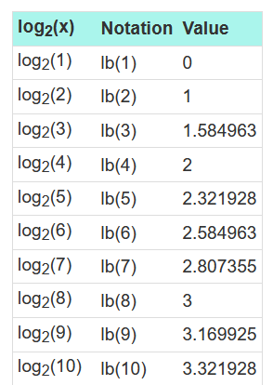
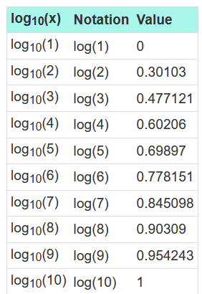

Slide 55
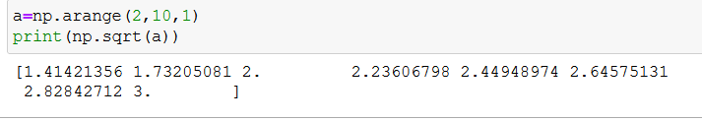
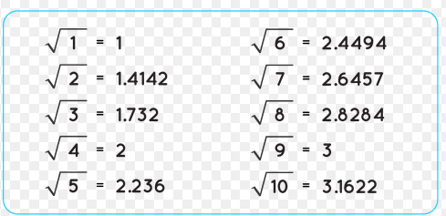
Square root function

Slide 56
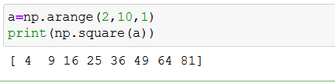
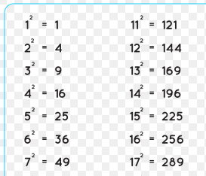
Square function

Slide 57
Rounding Functions
The numpy.round_() is a mathematical function that rounds an array to the given number of decimals.
Syntax : numpy.round_(arr, decimals = 0)

Slide 58
What will be output?
import numpy as np
a=np.array([11.23,24.05,24.90,25.16,26.53,26.62])
print(np.round(a,1))

Slide 59
numpy.floor()
The numpy.floor() is a mathematical function that returns the floor of the elements of array.

Slide 60
numpy.ceil() function
This function is used to return the ceiling value of the array values which is the smallest integer value greater than the array element.

Slide 61
What is the difference between summation and addition?

Slide 62
mport numpy as np
arr1 = np.array([1, 2, 3])
arr2 = np.array([1, 2, 3])
newarr = np.add(arr1, arr2)
print(newarr)

Slide 63
import numpy as np
arr1 = np.array([1, 2, 3])
arr2 = np.array([1, 2, 3])
newarr = np.sum([arr1, arr2])
print(newarr)

Slide 64
Products
To find the product of the elements in an array, use the prod() function.
Example
Find the product of the elements of this array:
import numpy as np
arr = np.array([1, 2, 3, 4])
x = np.prod(arr)
print(x)

Slide 65
Differences
import numpy as np
arr = np.array([10, 15, 25, 5])
newarr = np.diff(arr)
print(newarr)

Slide 66
We can use NumPy's unique() method to find unique elements from any array.
import numpy as np
arr = np.array([1, 1, 1, 2, 3, 4, 5, 5, 6, 7])
x = np.unique(arr)
print(x)

Slide 67
Finding Union
To find the unique values of two arrays, use the union1d() method.
import numpy as np
arr1 = np.array([1, 2, 3, 4])
arr2 = np.array([3, 4, 5, 6])
newarr = np.union1d(arr1, arr2)
print(newarr)

Slide 68
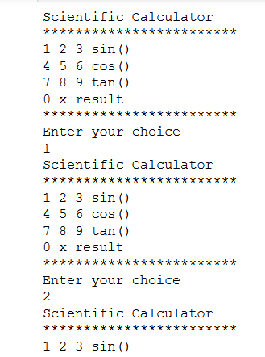

Slide 69
Finding the minimum and maximum elements from the array
The numpy.amin() and numpy.amax() functions are used to find the minimum and maximum of the array elements along the specified axis respectively.

Slide 70
numpy.where() function
This function is used to return the indices of all the elements which satisfies a particular condition.

Slide 71
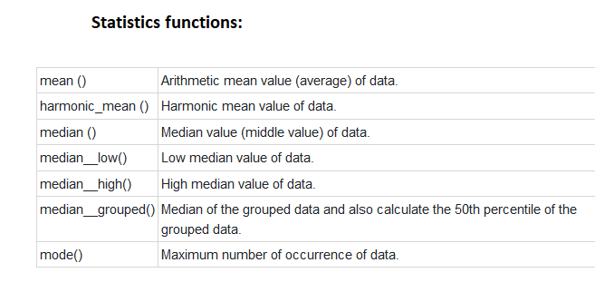

Slide 72


